Slide 1
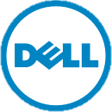
Prying the Cloud Open:
Dell Crowbar & OpenStack
Rob Hirschfeld (@zehicle), Principal Cloud Architect
Joseph B. George (@jbgeorge), Senior Cloud Strategist
July 2011, OSCON

Slide 2

Open Cloud Operations
Intersection of two major technology waves:
  Operational Automation (DevOps)
  Open Source Cloud (OpenStack)
Together, a practical approach to cloud scale
  Manages elastic resources
  Embraces constant change
  Productizes best practices

Slide 3
Lessons from Hyper-scale
Hyper-scale (1000s of servers) forced customers to change their core assumptions.
To operate large systems, customers
  Embraced scale out design (inconsistency is OK)
  Eliminated hardware redundancy (too expensive)
  Shunned manual steps (too slow)

Slide 4
Lessons from Public Clouds
Cloud servers forced customers to change their core assumptions.
To operate remote virtualized systems, customers
  Embraced scale out design (to get elastic growth)
  Lived with weak SLAs (that was all that was offered)
  Worked around lack of physical access (not available)

Slide 5
Clouds require an Operational Focus
Clouds demand significant operational and process controls
Operational decisions drive hardware and software decisions
We are finding ways to productize operations into best practices
SW
OPS
HW

Slide 6
DevOps Addresses Challenges
DevOps is an operational approach that automates system configuration and management.
To manage cloud systems, customers
  Need to manage servers as groups
  Must respond to rapid infrastructure changes
  Have repeatable automated deployments

Slide 7
Missing Cloud Infrastructure
The cloud market was highly fragmented
Amazon dominated but was not public domain
VMware was building on their enterprise base
Microsoft was taking the PaaS route
Many small players but no community projects
Service Providers could not agree on APIs

Slide 8
Community Cloud Infrastructure
We needed Cloud Infrastructure that
Had support from major industry players
Was collaboratively developed without a single owner
Had an API that was Service Provider license friendly
Could be demonstrated to run at scale
Was built on open source components
Had global reach and support

Slide 9
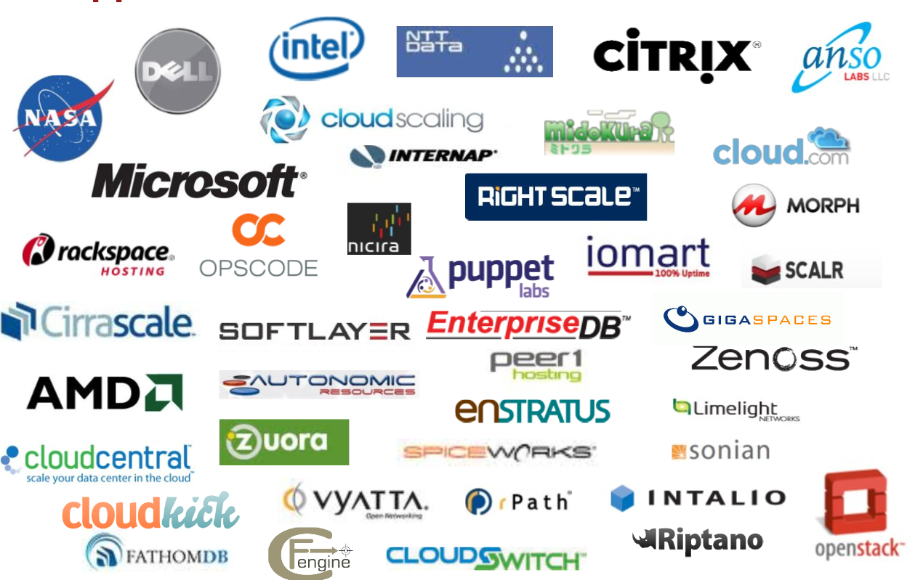
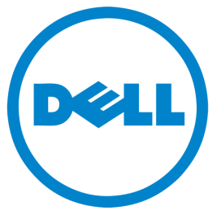

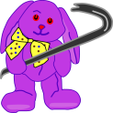
OpenStack!

Slide 10

Making an OpenStack Cloud
? Operations
SW
OPS
HW
Resources ?
? Expertise

Slide 11
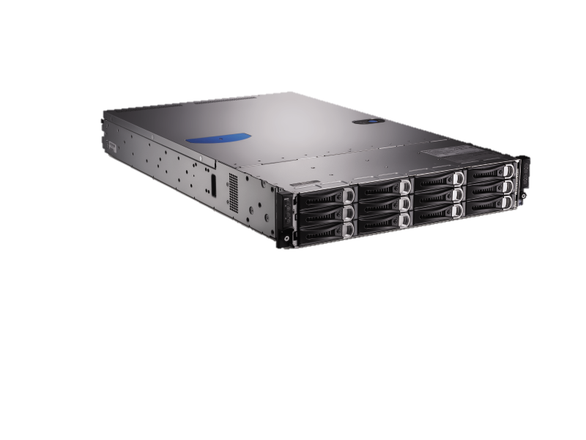
Dell OpenStack Cloud Solution
“Crowbar”
CloudOps
Software
SW
SW
OPS
HW
OPS
Reference
Architecture
Services &
Consulting

Slide 12
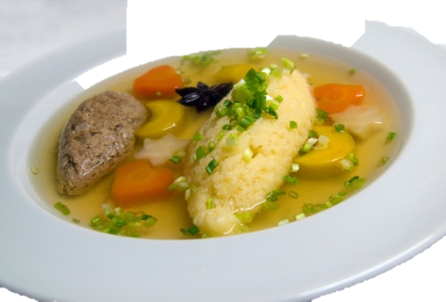
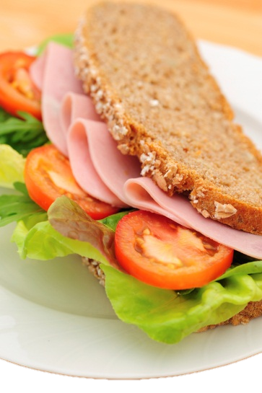
How DevOps is Different
Images vs. Layers
TECHNICAL CONTENT AHEAD
$
$

Slide 13
Images vs. Layers: Overview
Images: Single Unit
Layers: Stacked Pieces
Configuration
Configuration
Integrations
Integrations + Applications +
Utilities + Operating System
Application Foo
Application Bar
Utilities
Operating System

Slide 14
Images vs. Layers: Lifecycle
Images: Replacement
Layers: Upgrade
Config
Config
Config
I+A+U+O/S
I+A+U+O/S
I+A+U+O/S
I
I
Config
Config
Foo
Foo
Bar v1
Bar v2
U
U
OS
OS
Config
Bar v2
I+A+U+O/S

Slide 15
Images vs. Layers: Details
Images
Layers
Like a Compiled Language
Early Binding
Tightly Coupled
Assembled as a package
1-Step Deployment
Big Storage Footprint
Cloned from “Golden Image”
Single Version
Like an Interpreted Language
Late Binding
Loosely Coupled
Assembled in parts
Multi-Step Deployment
Small Footprint (packages)
Setup per instance
Discrete Versions

Slide 16
Images vs. Layers: Mo’ Details
Images
Layers
Very Static Operations
Manual Setup
Low Entry / High Maintenance
Works well in Enterprise
Hardware Sensitive
Brittle
Typically: Windows
High Change Operations
Automated setup
High Entry / Low Maintenance
Works well in Cloud
Hardware Agnostic
Elastic
Typically: Linux

Slide 17
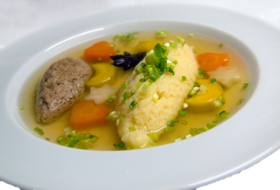
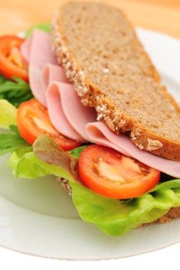
Images vs. Layers
Soup
Sandwich
Delicious!
Fast!
Premixed
Hard to customize
Hard to change
Hard to carry
Every batch is unique
Delicious!
Fast!
Flexible
Easy to customize
Configurable
Very portable
Components can be common

Slide 18
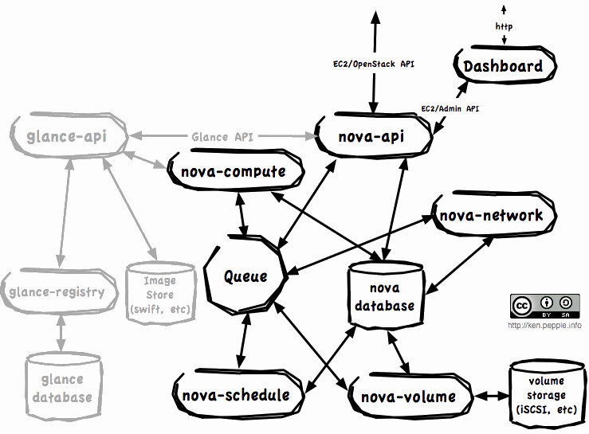
Cloud Deployments are Complex
Crowbar has scripts that install the components of OpenStack Nova in a proven pattern that can be customized after the fact.
Source: Ken Pepple

Slide 19
CloudOps for OpenStack
There are lot of pieces, but they share many elements!
I
I
I
I
I
I
Config
Config
Config
Config
Config
Config
Crowbar
Chef
Nagios
Dash Board
Nova
Cntrl
Nova
DB
Nova
API
U
U
U
U
U
U
OS
OS
OS
OS
OS
OS
I
I
I
I
I
I
Config
Config
Config
Config
Config
Config
Nova
Node
Nova
Node
Nova
Node
Nova
Node
Nova
Node
Nova
Node
U
U
U
U
U
U
OS
OS
OS
OS
OS
OS

Slide 20
CloudOps for OpenStack
Plus interconnections are highly complex and dynamic
I
I
I
I
I
I
Config
Config
Config
Config
Config
Config
Crowbar
Chef
Nagios
Dash Board
Nova
Cntrl
Nova
DB
Nova
API
U
U
U
U
U
U
OS
OS
OS
OS
OS
OS
I
I
I
I
I
I
Config
Config
Config
Config
Config
Config
Nova
Node
Nova
Node
Nova
Node
Nova
Node
Nova
Node
Nova
Node
U
U
U
U
U
U
OS
OS
OS
OS
OS
OS

Slide 21
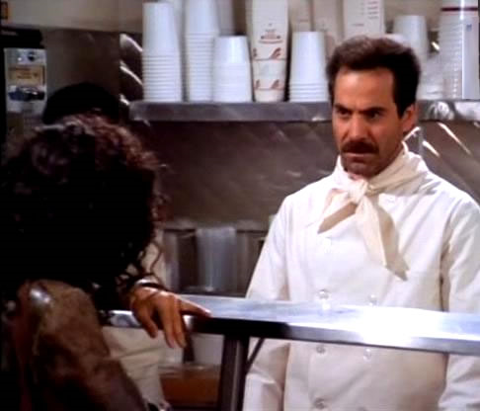
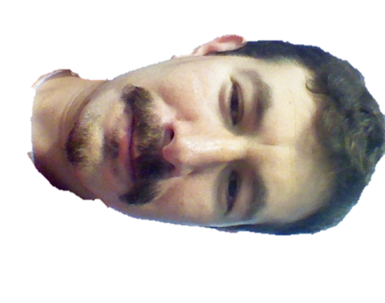
No soup for you!

Slide 22
Crowbar Deep Dive
WARNING: TECHNICAL CONTENT AHEAD
$
$

Slide 23
What is Crowbar?
Mission: “A Zero Touch Cloud Installer”
  Servers in boxes to full function cloud in under 2 hours
Fast & Flexible
  Bare metal install including BIOS & RAID config
  Users can choose how their system is configured (“barclamps”)
DevOps Embracing
  Ongoing Operations Model (DevOps for Clouds)
  Leverages & Wraps Opscode Chef
Open
  Not specific to OpenStack – Dell using for other Apps
  Not restricted to Dell hardware
  Apache 2 licensed

Slide 24
Crowbar Stages of Deployment
Includes all the components required to implement an entire cloud infrastructure including ecosystems partners
Pluggable components deploy cloud infrastructure.
Allow for addition of Dell IP and expansion by the community services and customers
Can integrate with Dell existing products
Delivers basic data center services and required cloud infrastructure.
Provision bare-metal servers from box to cloud WITHOUT user intervention (other than racking/cabling and some minimal configuration questions) NOT EXCLUSIVE TO DELL HARDWARE
Dell “Crowbar”
Ops Management
APIs, User Access, & Ecosystem Partners
Cloud Infrastructure & Dell IP Extensions
Core Components & Operating Systems
Physical Resources
* Crowbar has potential to service other programs beyond OpenStack

Slide 25
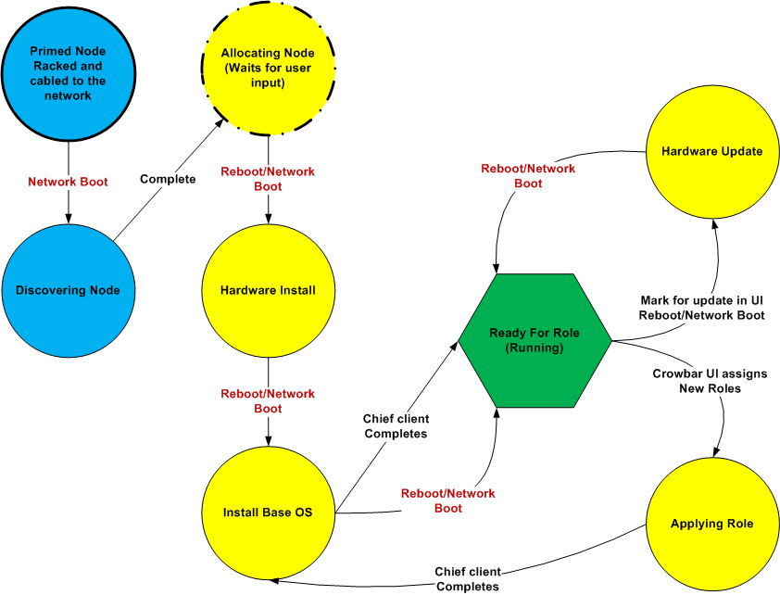
Crowbar = Install State Machine

Slide 26
Modular Design: Barclamps
Dell “Crowbar”
Ops Management
APIs, User Access, & Ecosystem Partners
Nagios
Ganglia
Dashboard
Cloud Infrastructure & Dell IP Extensions
Nova
Swift
Glance
Compellent
EqualLogic
Core Components & Operating Systems
Crowbar
DNS
Logging
Deployer
NTP
Physical Resources
Provisioner
BIOS
IPMI
Network
RAID
* Crowbar has potential to service other programs beyond OpenStack

Slide 27
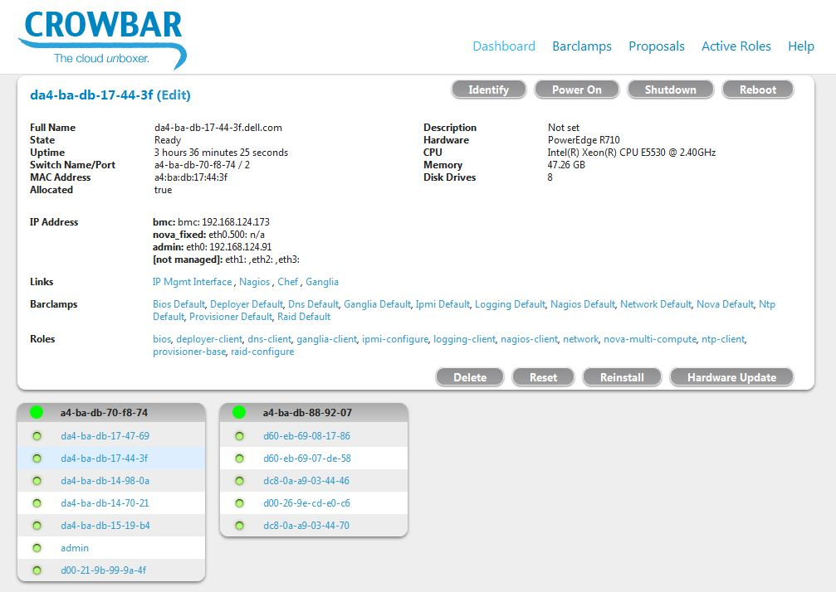
Live Demo (placeholder)

Slide 28
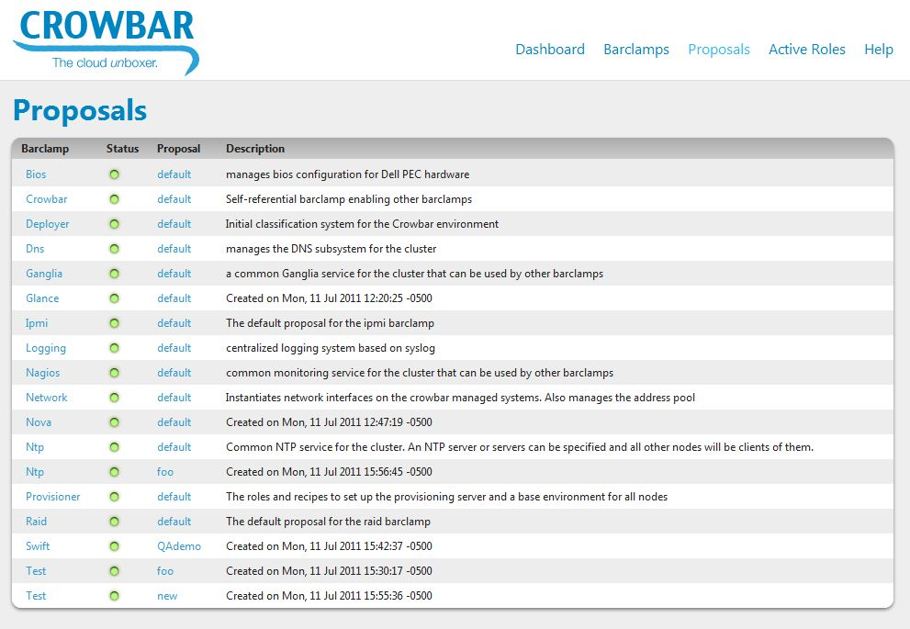
Live Demo (placeholder)

Slide 29
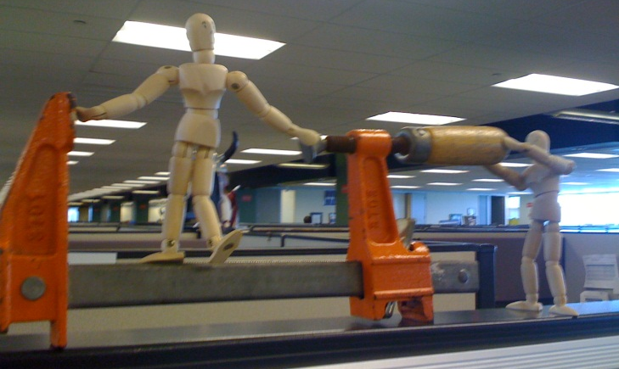
In Conclusion,

Slide 30
Open Cloud Operations
Intersection of two major technology waves:
  Operational Automation (DevOps)
  Open Source Cloud (OpenStack)
Together, a practical approach to cloud scale
  Manages elastic resources
  Embraces constant change
  Productizes best practices

Slide 31
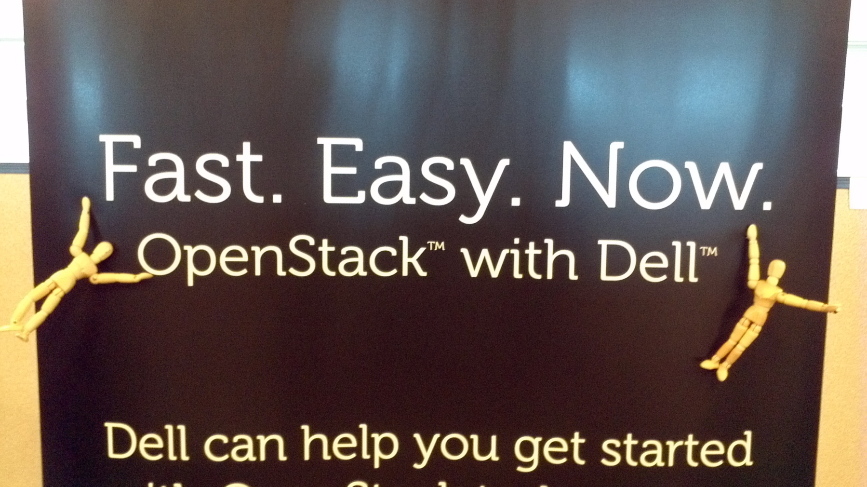
OpenStack + Crowbar =

Slide 32
Questions?
More info:
http://Dell.com/OpenStack - White Papers & More!
http://RobHirschfeld.com – Technical & Agile
http://JBGeorge.net – Business & Marketing

